Slide 1
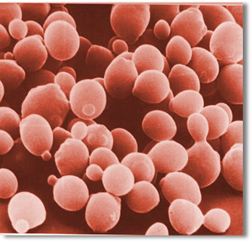
Is Yeast Alive?

Slide 2
Problem:
Yeast consists of tiny brownish grains that are used by humans to make bread. Are these tiny grains alive?

Slide 3
Background:
To find out whether yeast is alive it must demonstrate some characteristics of living organisms. (What are some characteristics of living organisms?)

Slide 4
Hypothesis:
If yeast is alive, then energy will be produced (the balloon will fill with carbon dioxide).

Slide 5
Materials:
Magnifying glass
Packet of yeast
Sugar packet
Balloon
Plastic soda/water bottle

Slide 6
Procedures:
Observe yeast in packet with a magnifying glass. Record observations.
Fill empty soda/water bottle about two-thirds full with warm water.
Add _____ sugar packets to bottle.
Add the packet of yeast to the bottle and shake gently to stir.
Quickly place the balloon over the opening of the bottle, making sure that the balloon fits tightly around the neck of the bottle.
Place the bottle in a warm place away from drafts. Observe carefully. Record your observations.

Slide 7
Analysis:
View of Yeast through Magnifying Glass

Slide 8
Analysis:
Before: | After:

Slide 9
Conclusion:
3 Paragraphs:
Hypothesis-valid or invalid---explain why valid or invalid with results.
Science Concept---explain in great detail
Revisions

Slide 10
Application:
One Paragraph:
Real-life connection

Slide 11
Bibliography
Bernstein, P. (2011). Is yeast alive? Retrieved from: https://serendip.brynmawr.edu/sci_edu/waldron/pdf/IsYeastAliveProtocol.pdf

